Slide 1
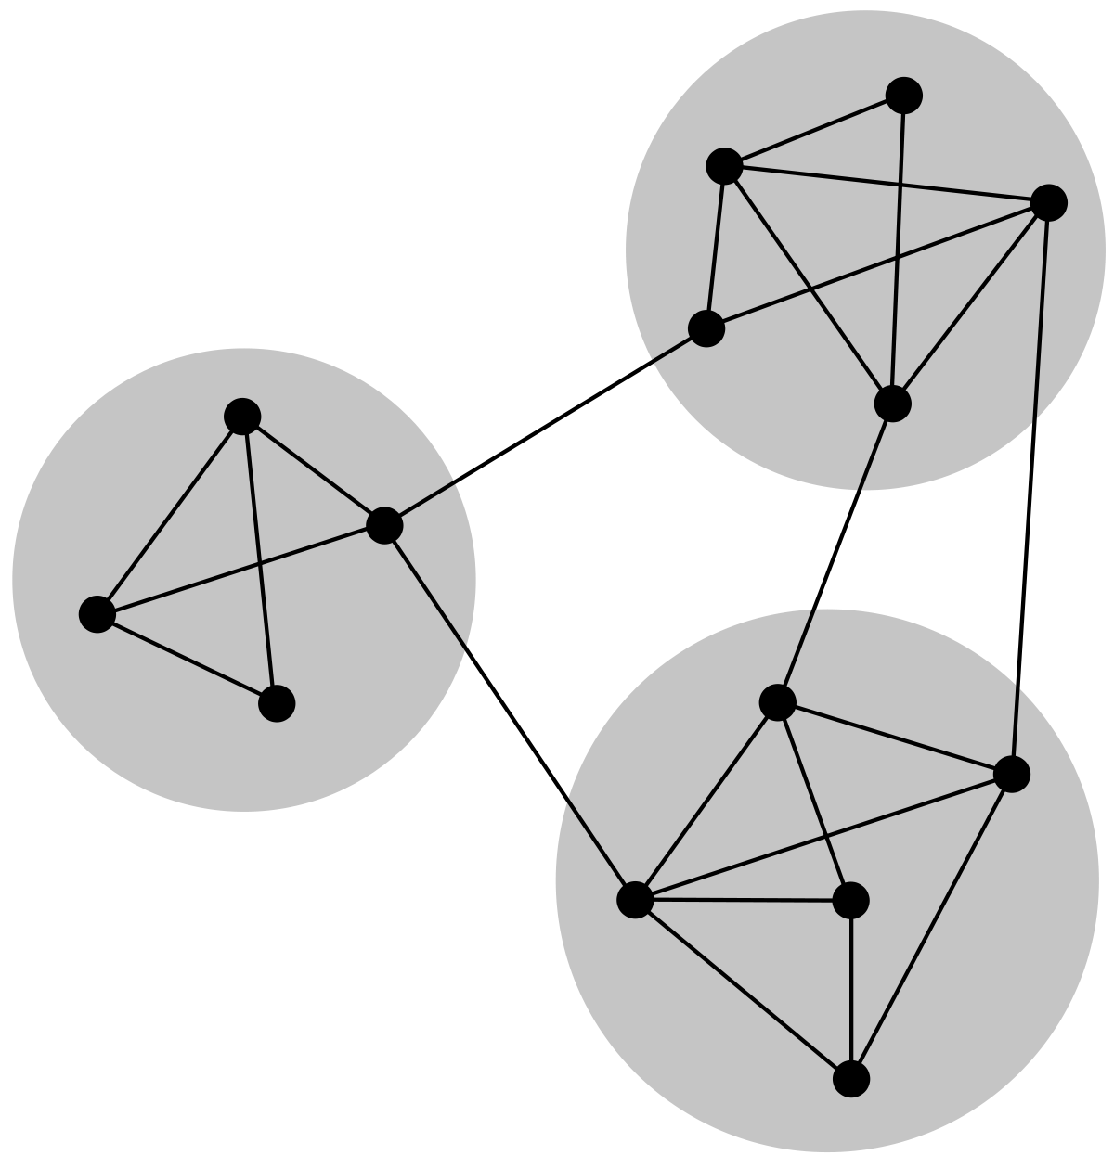
Graph
NLP
for
ConvNets
By Ankit Pal
SHALA2020
https://shala2020.github.io/

Slide 2
Who Am I?
AI Research Engineer @ Saama AI Lab
I work in Graph and NLP field
I am interested in
Representation Learning on Graphs and Manifolds
Unsupervised & Meta learning
Neural Architecture Search
Spiking Neural networks
Biomedical signal processing
Github

Slide 3
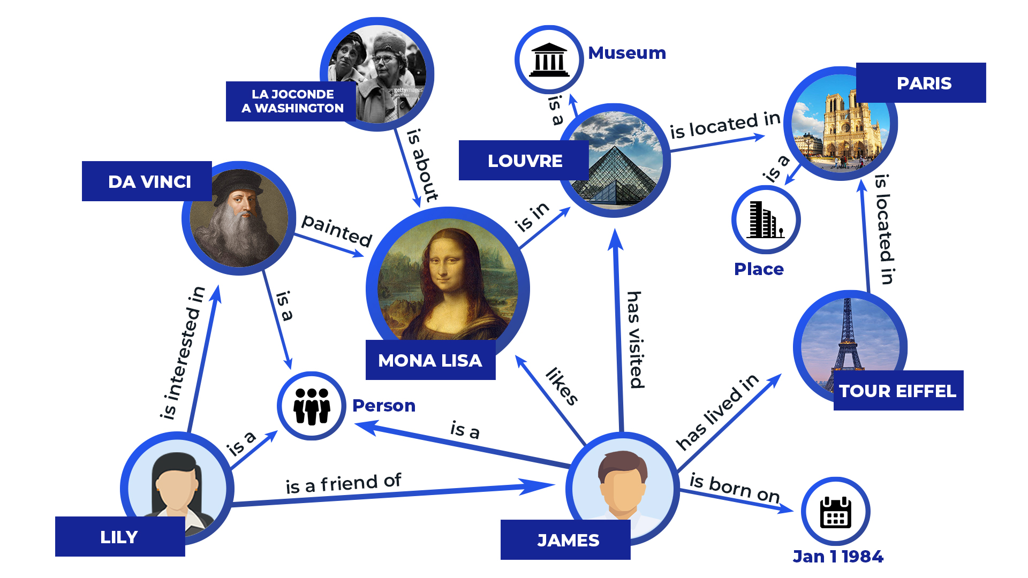
Google Knowledge Graph
Connect the Nodes..

Slide 4
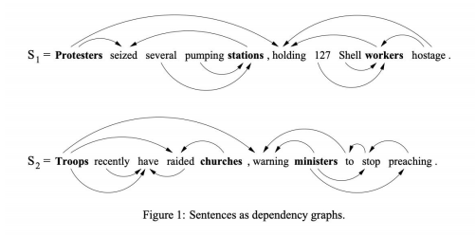
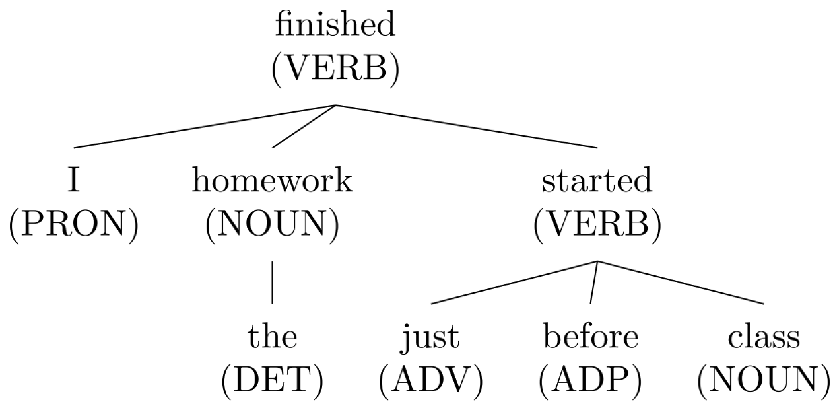
Graphs in NLP..

Slide 5
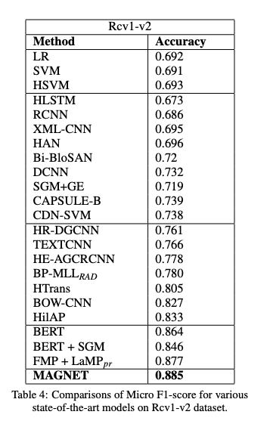
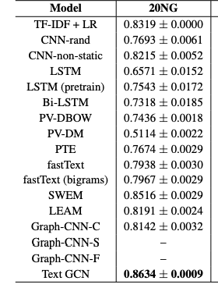
Why NLP on Graphs?
[ Pal, Ankit et al. “Multi-Label Text Classification
using Attention-based Graph
Neural Network.” ICAART (2020)]
[ Text-GCN, Yao et al., 2019 ]

Slide 6
Outline of Today’s Lecture
Graph Convolutional Networks
Overview of GCN
Formulation
Hello World in Deep learning on Graph
Implementation of GCN
Applications
Text Classification
Text-GCN Paper
Feature extractor
Magnet Paper
Knowledge Graph
KG Paper

Slide 7
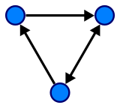
Graph Convolutional Networks
Graph, who?
In Computer Science, a graph is a data structure consisting of two components, vertices and edges. A graph G can be well described by the set of vertices V and edges E it contains.
G = (V, E)
Edges can be either directed or undirected, depending on whether there exist directional dependencies between vertices.

Slide 8
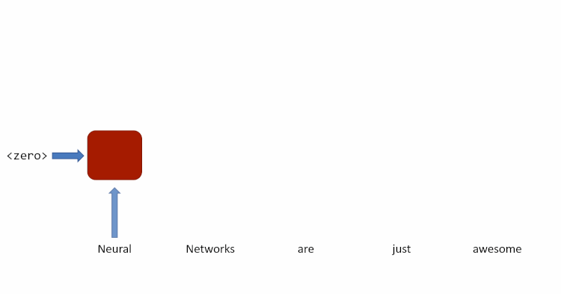
Graph Convolutional Networks
This recurrent simply combines the input — a word for instance — with the output of itself from the previous time-step and passes it through a tanh activation to get the output of the current time-step.

Slide 9

Graph Convolutional Networks
Replace the state with message, Each element in the sequence updates the message to incorporate information about itself so that the message reflects the information in the sequence as it is processed.
Carried state as a message that’s passed between the sequence elements.

Slide 10
Graph Convolutional Networks
Replace the state with message, Each element in the sequence updates the message to incorporate information about itself so that the message reflects the information in the sequence as it is processed.
Carried state as a message that’s passed between the sequence elements.

Slide 11
Graph Convolutional Networks
What if an element send a message to the next one on each timestep of the sequence,
Carried state as a message that’s passed between the sequence elements.

Slide 12
Graph Convolutional Networks
length of the sequence = Number of time steps
Essentially, copies of the RNN cell are made over time (unrolling/unfolding), with different inputs at different time steps.
But graphs can be arbitrarily big and flexible.
RNN unfold each time step for a message to collect information about it in its entirety. It might seem as though this is a lot of unnecessary work.

Slide 13
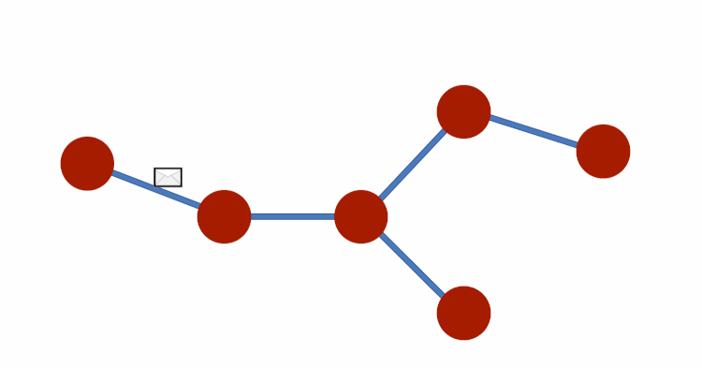
Graph Convolutional Networks
As we applied message passing on sequences, We can apply same idea of message-passing on Graphs

Slide 14
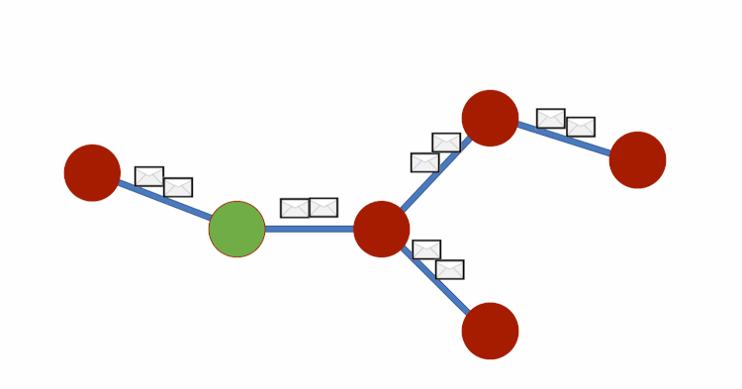
Graph Convolutional Networks
In each GCN layer, all nodes are supposed to receive information from neighboring nodes. Consider each element is passing messages to the elements it connects to — after a few timesteps with exchanges, each node will hold messages that contain information. After Aggregating this information, The representation of each node (each row) is now a sum of its neighbors features!

Slide 15
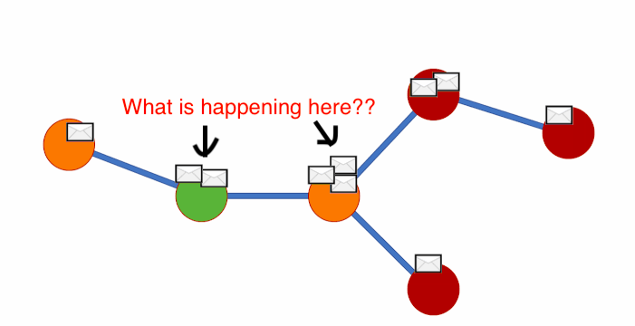
How this Aggregation is performed?

Slide 16
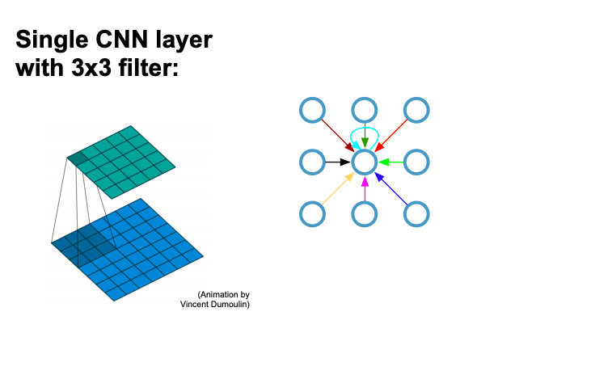
Recap: Convolutional neural networks (on grids)

Slide 17
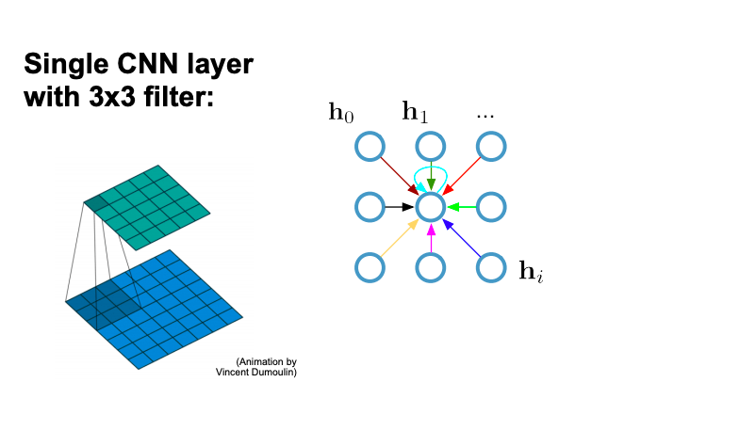
Recap: Convolutional neural networks (on grids)

Slide 18
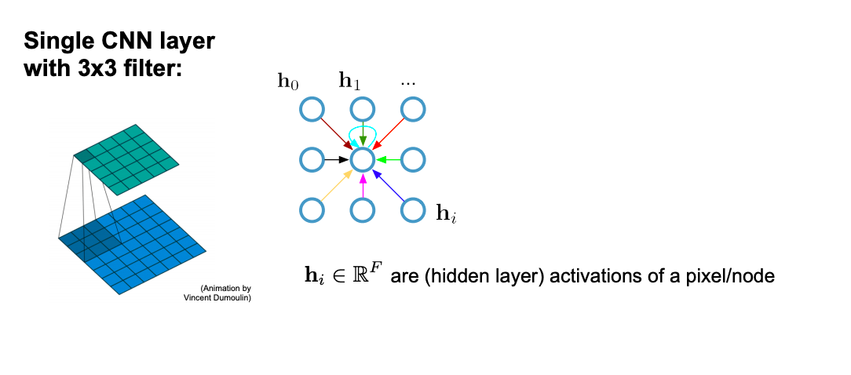
Recap: Convolutional neural networks (on grids)

Slide 19
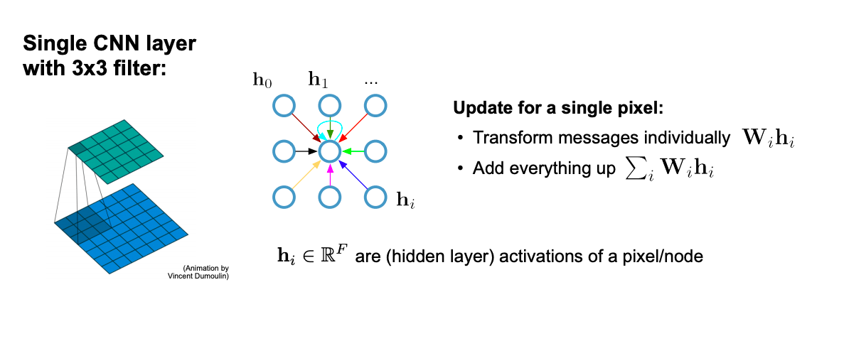
Recap: Convolutional neural networks (on grids)

Slide 20
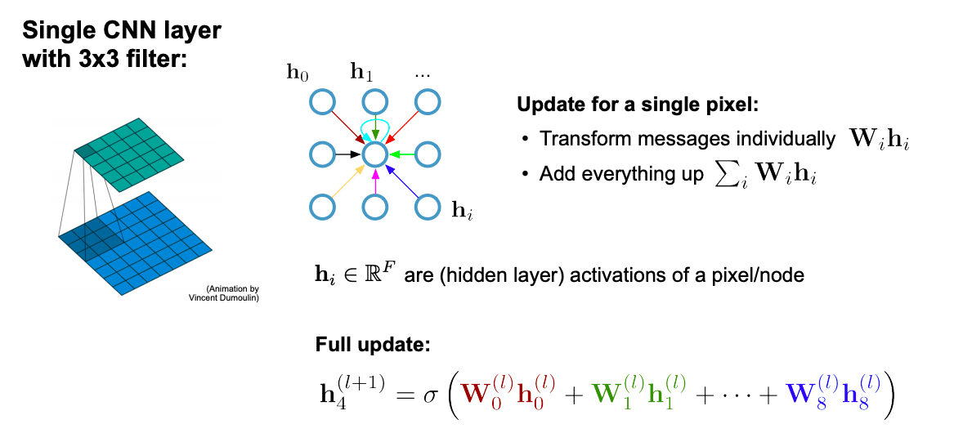
Recap: Convolutional neural networks (on grids)

Slide 21
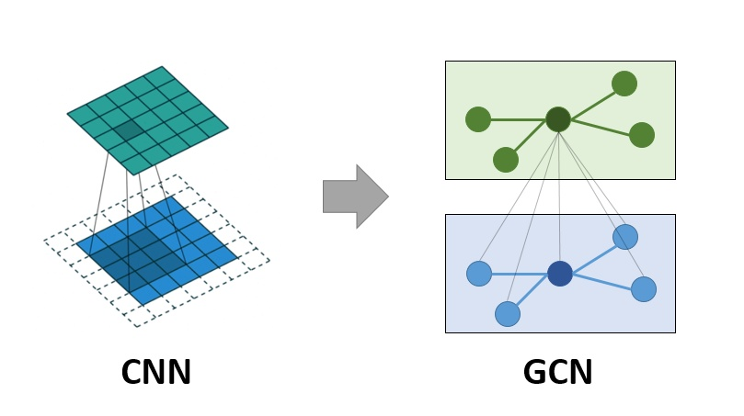
Comparing

Slide 22
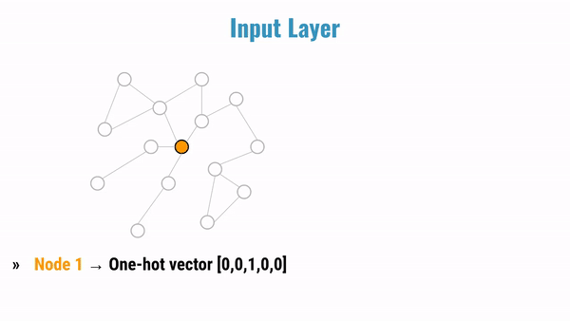
More Animation

Slide 23
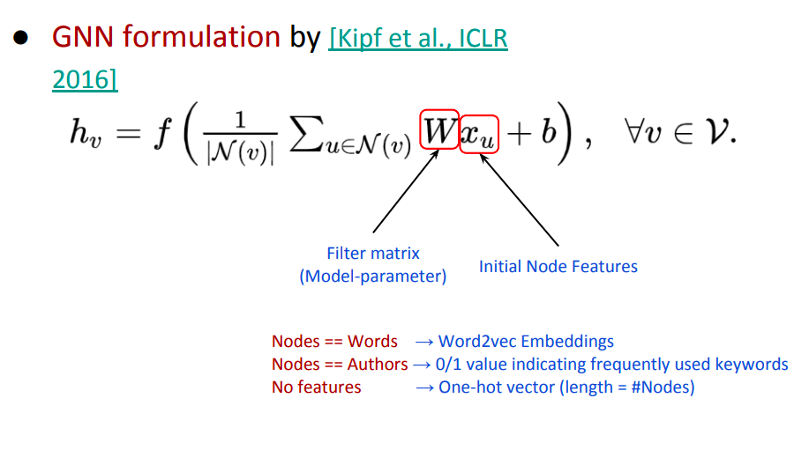
Formulation

Slide 24
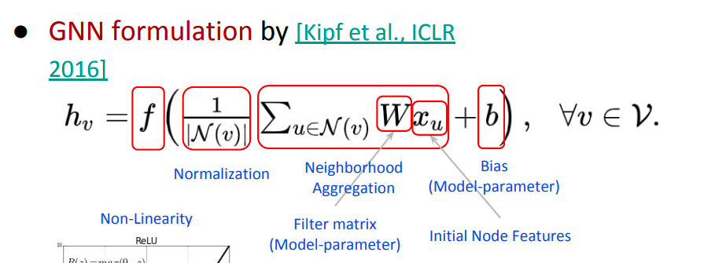
Formulation

Slide 25
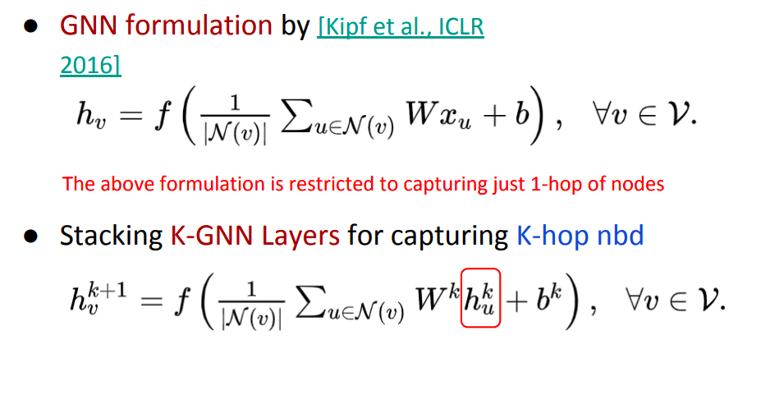
Formulation

Slide 26
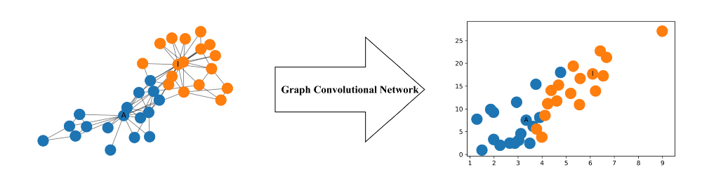
Hello World in Deep Learning on Graph
Let’s Understand by practical examples :

Slide 27
Hello World in Deep Learning on Graph
Given a graph G = (V, E), a GCN takes as input
an input feature matrix N × F⁰ feature matrix, X, where N is the number of nodes and F⁰ is the number of input features for each node, and
an N × N matrix representation of the graph structure such as the adjacency matrix A of G.

Slide 28
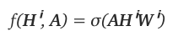
Hello World in Deep Learning on Graph
A Simple Propagation Rule
where Wⁱ is the weight matrix for layer i and σ is a non-linear activation function such as the ReLU function. The weight matrix has dimensions Fⁱ × Fⁱ⁺¹; in other words the size of the second dimension of the weight matrix determines the number of features at the next layer. this operation is similar to a CNN’s filtering operation since these weights are shared across nodes in the graph.

Slide 29
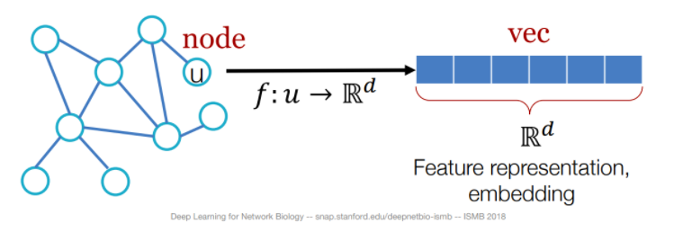
Hello World in Deep Learning on Graph
Every Node is a vector of d dimension

Slide 30
Hello World in Deep Learning on Graph
Jupyter Notebook explanation

Slide 31
Key Points from Notebook
In Graph based Models, using the Adjacency Matrix(A) enable the model to learn the features of neighboring nodes.
Thomas Kipf and Max Welling (2017) Used the Renormalization trick to normalize the features in Fast Approximate Spectral-based Graph Convolutional Networks.
GCNs can learn features representation to cluster even before training.

Slide 32
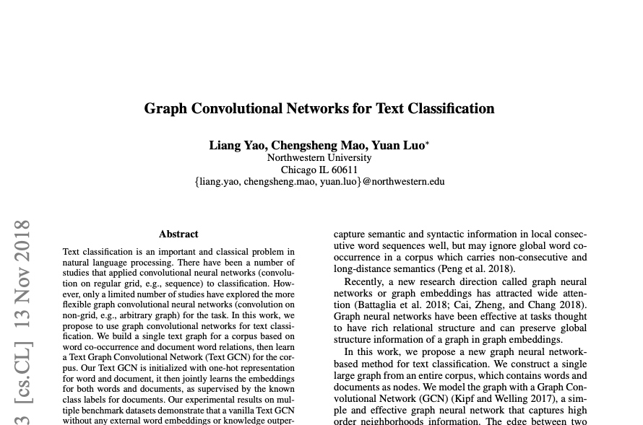
Applications
Text Classification using GCN
Key Points of Research Paper
Embedding the entire corpus into a single graph with
documents
some labelled and some unlabelled
words as nodes, with each document-word
and word-word edges
Assigning weights based on their relationships

Slide 33
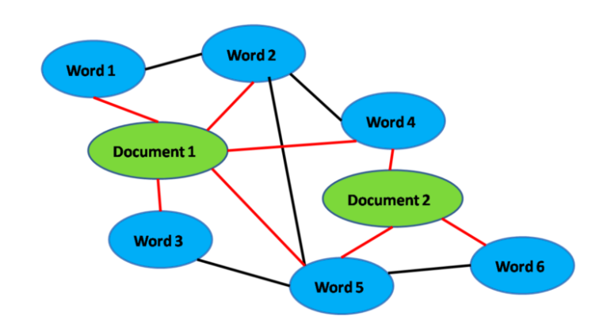
Applications
Convert Text data into Graph
Corpus represented as a heterogeneous graph . Red lines represent document-word edges weighted by TF-IDF, Black lines represent word-word edges weighted by PMI.

Slide 34
Text dataset to Graph
Eight steps to convert Text dataset into Graph
Text Preprocessing on Raw Corpus
Building Vocabulary from Preprocessed dataset
Creating n-gram set from Preprocessed dataset
Count single word freq in N-gram
Count Bigram frequency in N-gram
Calculate tf-idf for single word frequency
Calculate PMI score for Bigram frequency
Embedding the entire corpus using Heterogeneous Graph

Slide 35
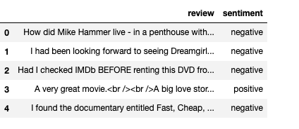
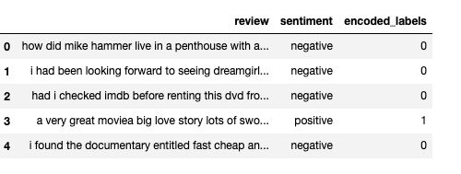
Text Preprocessing on Raw Corpus
We are using IMDB Review Dataset, Using only few rows (sentences ) to understand the process better
Raw Dataset
Preprocessed Dataset
Text Preprocessing : Remove HTML tags, remove special characters, make lowercase, etc...

Slide 36
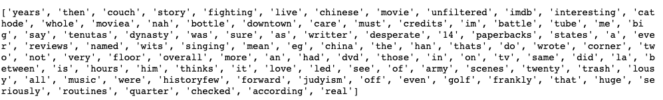
Building Vocabulary from Corpus
Making a list of unique words from preprocessed dataset.

Slide 37
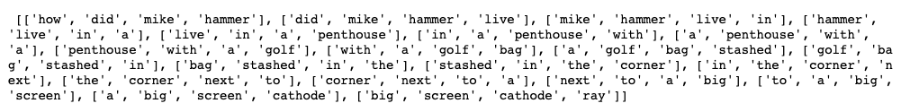
Creating n-gram set from Vocabulary
Creating a set of N-gram from Preprocessed dataset
For demo purpose, let’s use n = 4

Slide 38
Count single word frequency in n-gram
How many times a word appears in n-gram where n = 4

Slide 39
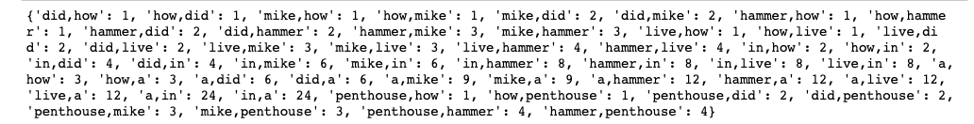
Count bigram frequency in n-gram
How many times a bigram appears in n-gram where n = 4

Slide 40
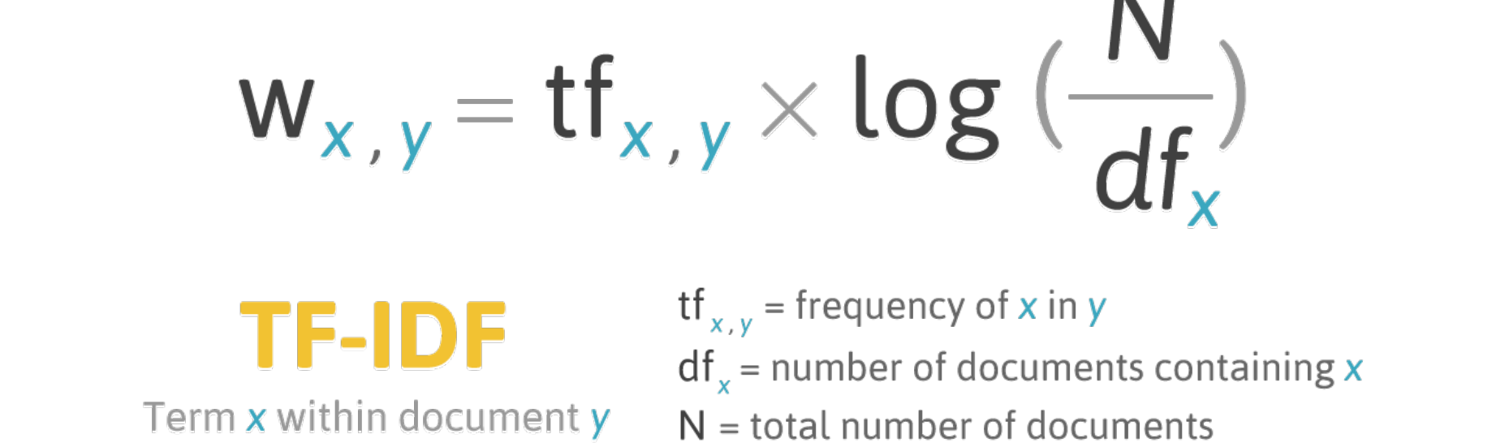
Tf-idf : Term frequency–inverse document frequency
Tf-idf is a statistical measure used to evaluate how important a word is to a document in a collection or corpus.

Slide 41
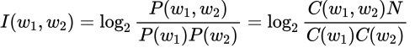
PMI : Pointwise mutual Information
Mutual Information has to do with the amount of information word W₁ adds to the word W₂
A high positive PMI between pairs of words means that they have a high semantic correlation, conversely we do not build edges between words with negative PMI.
Overall, TF-IDF-weighted document-word edges capture within-document context, while PMI-weighted word-word edges (which can span across documents) capture across-document contexts.

Slide 42
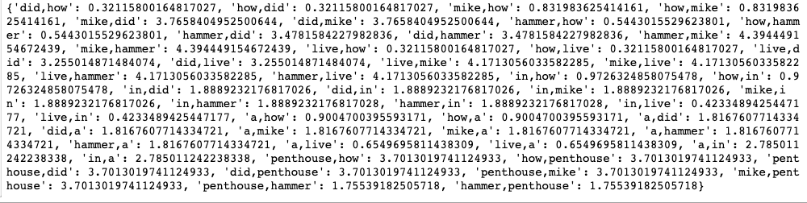
PMI : Pointwise mutual Information

Slide 43
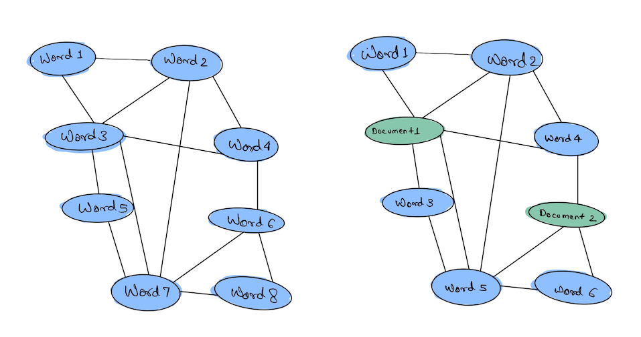
Building Heterogeneous Graph
A graph with two or more types of node and/or two or more types of edge is called heterogeneous.
Homogeneous Graph Heterogeneous Graph

Slide 44
Building Heterogeneous Graph
We have converted the Text Data into Graph, Now what?
Before feeding the data to GCN model, Let’s first understand the implementation of GCN..

Slide 45
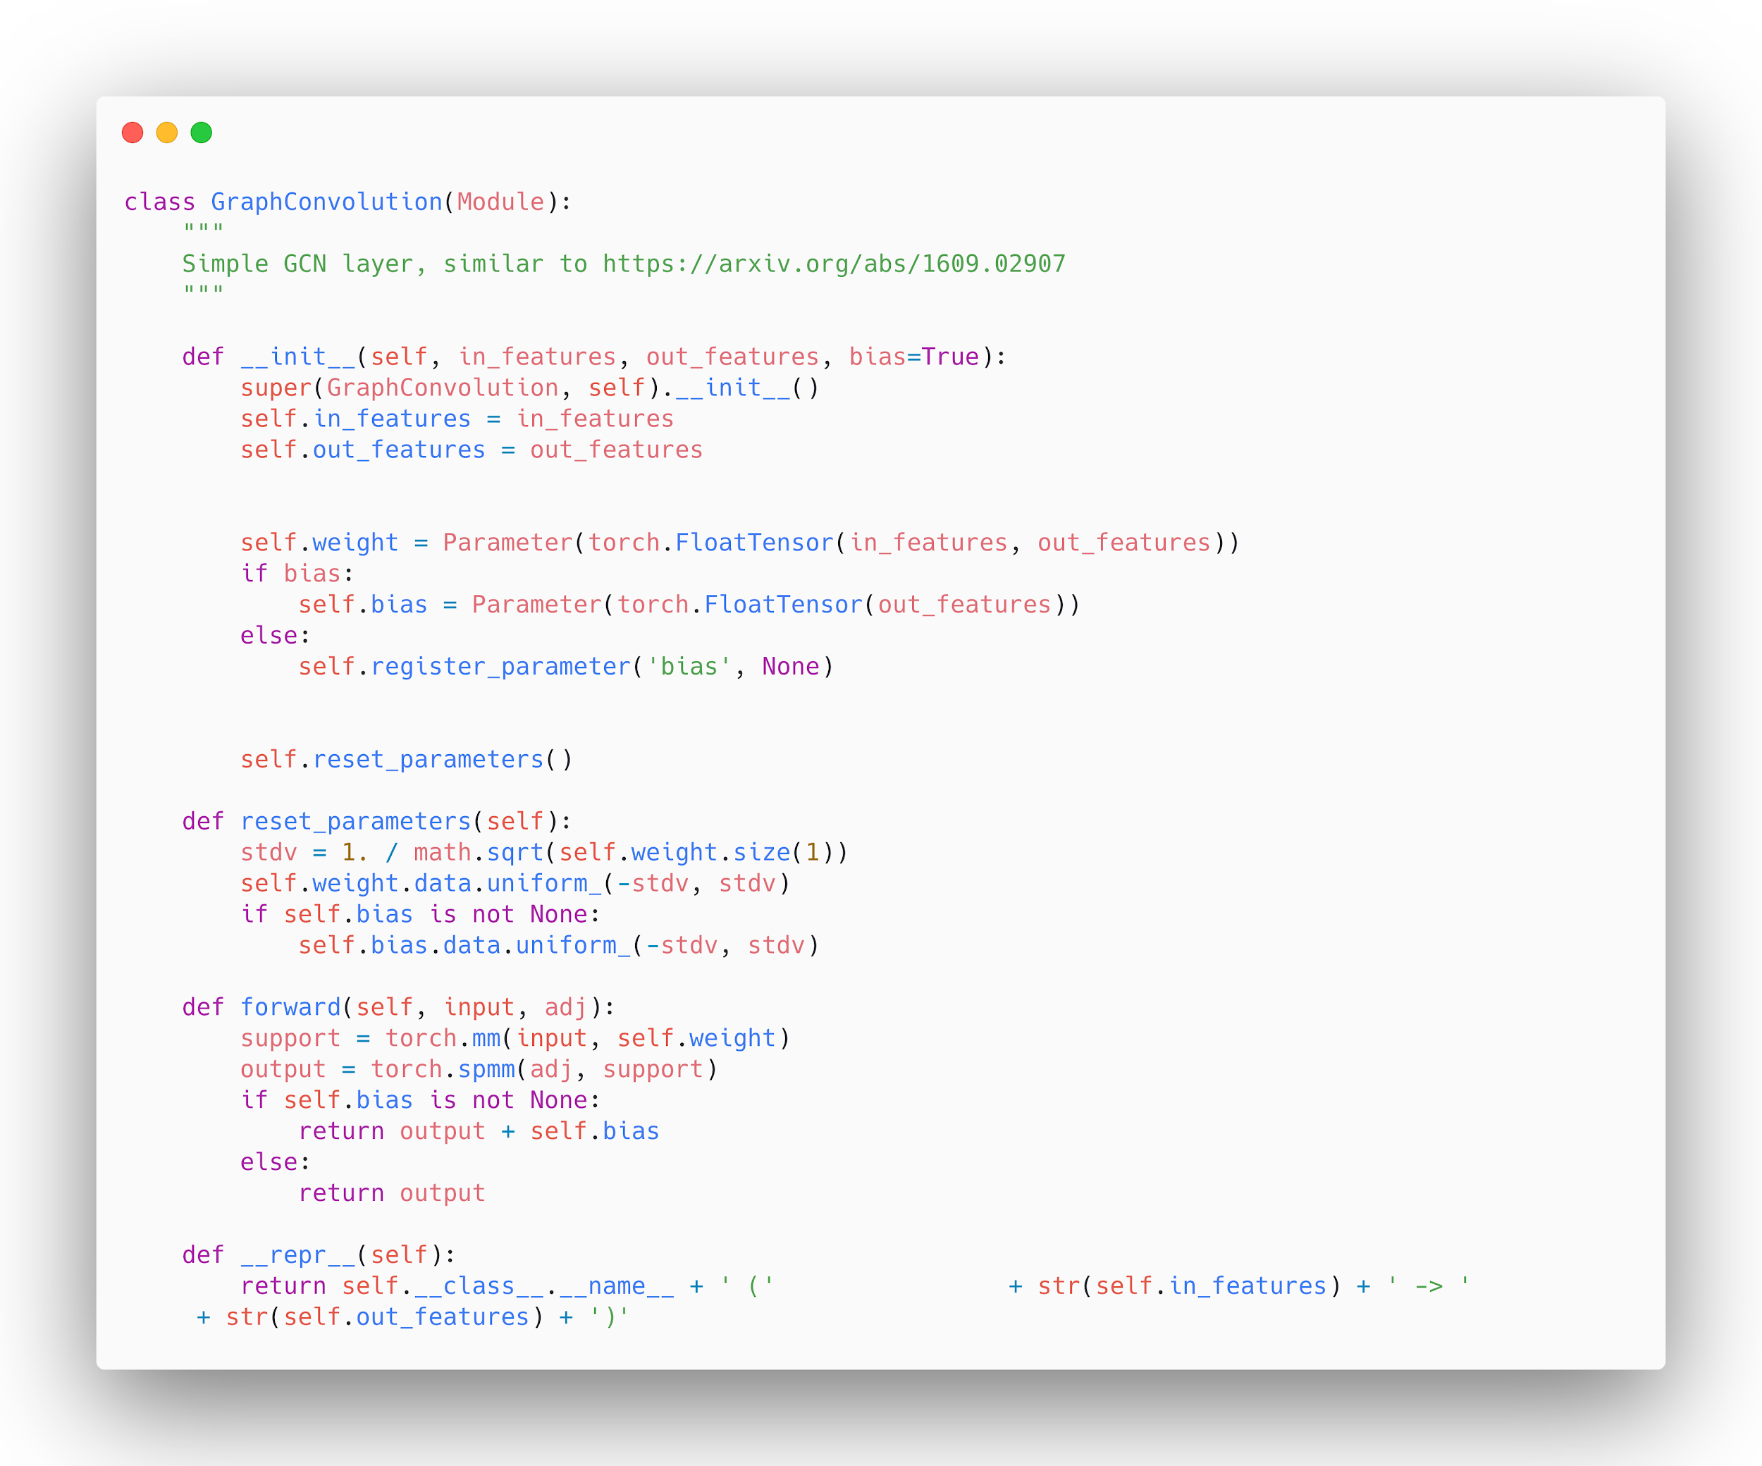
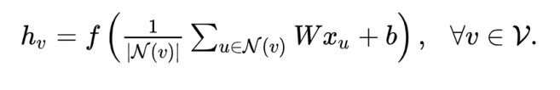
Implementation of GCN

Slide 46
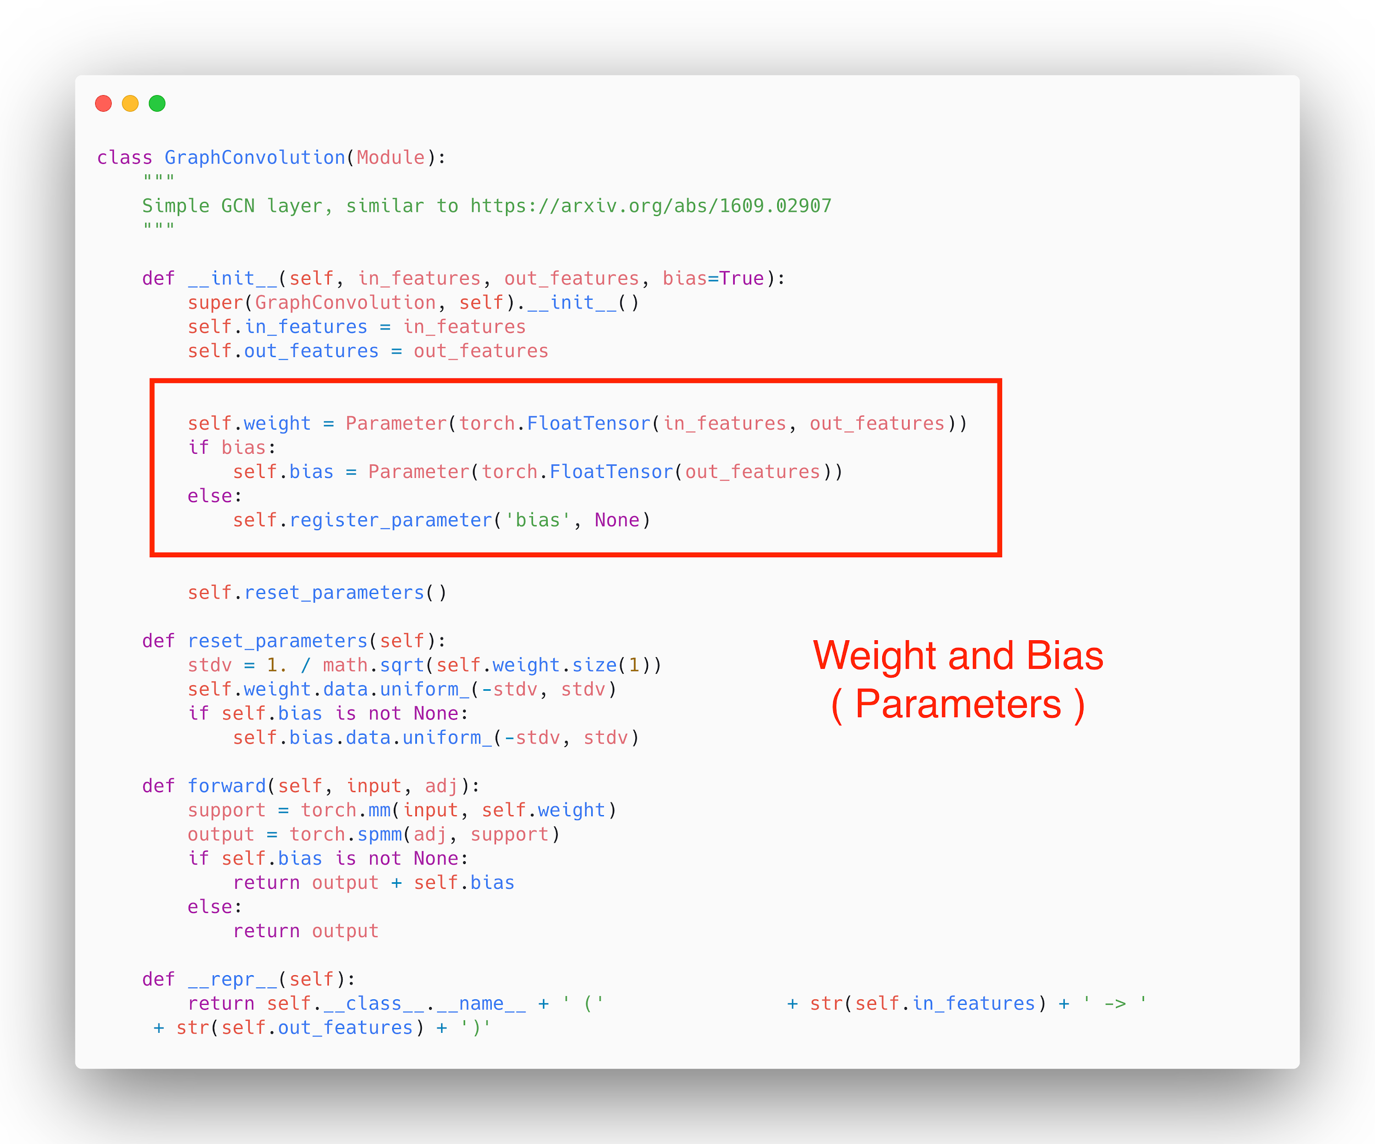
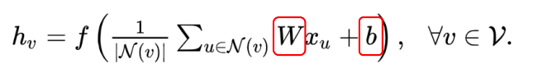
Implementation of GCN

Slide 47
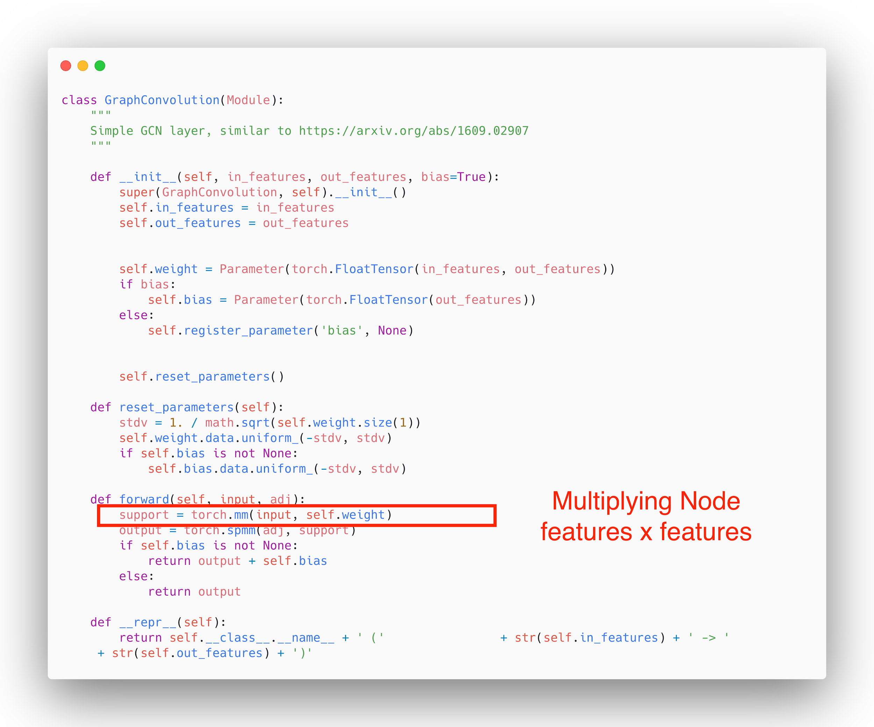
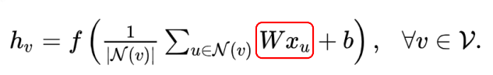
Implementation of GCN

Slide 48
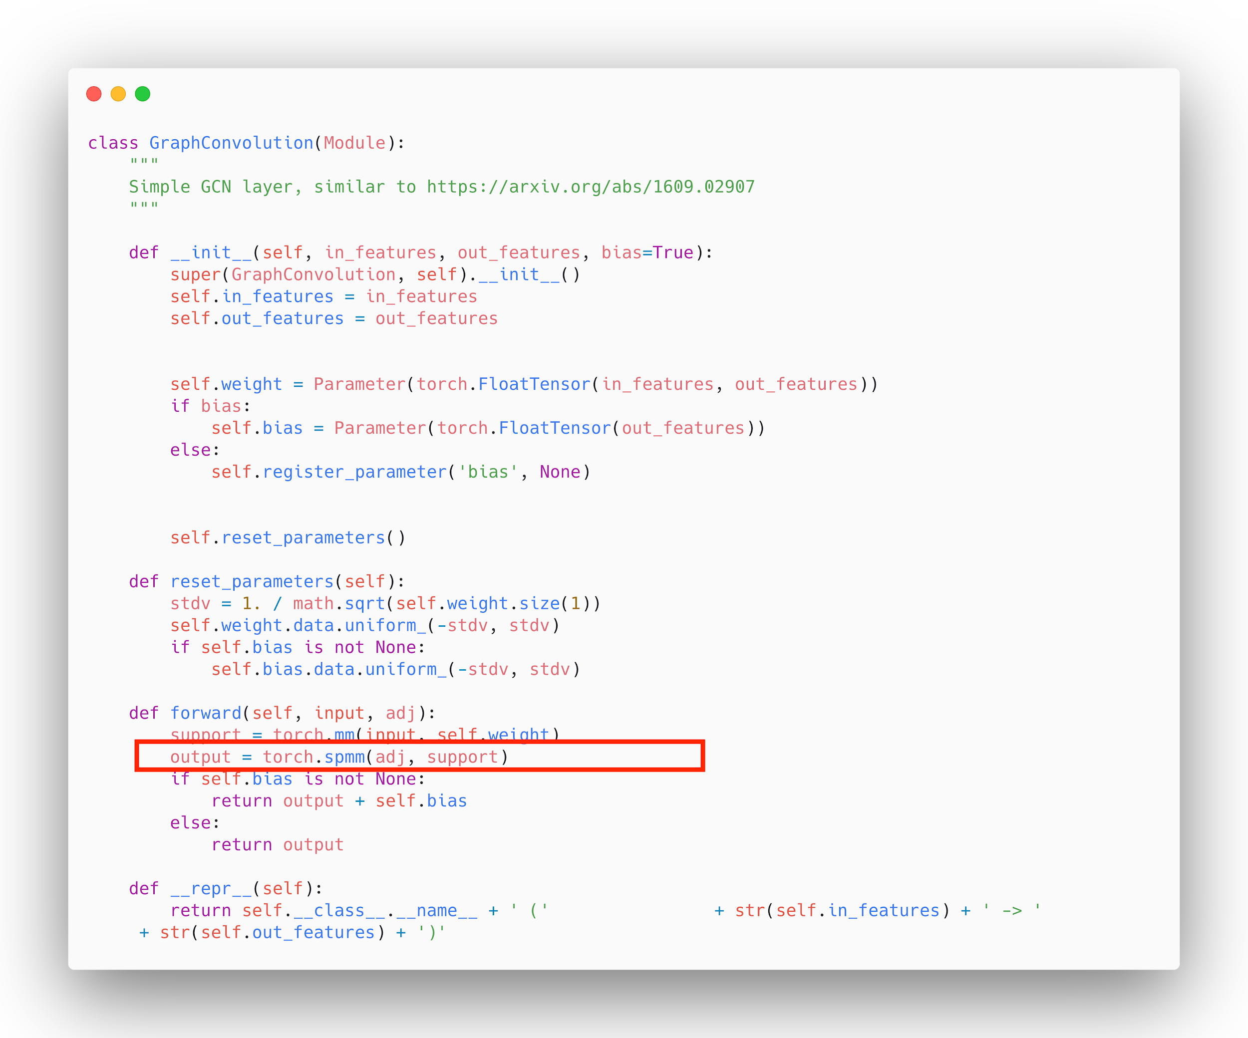
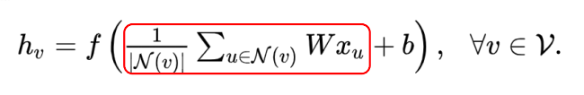
Implementation of GCN

Slide 49
Implementation of GCN
Jupyter Notebook : 2 Demo of Sentiment Analysis with GCN

Slide 50
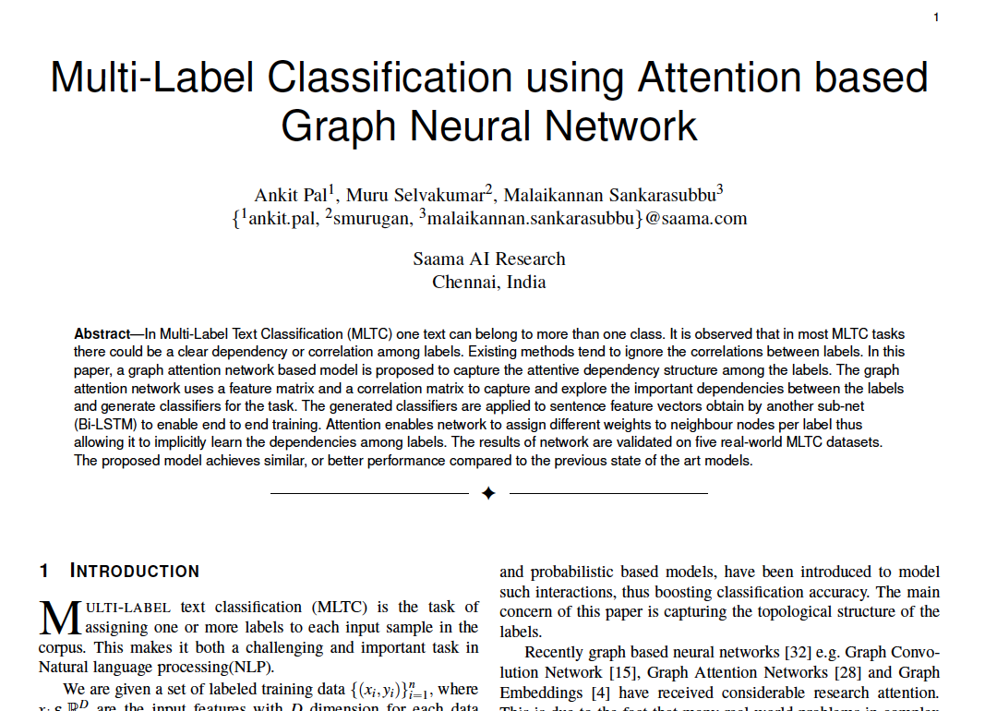
Applications
MAGNET: Multi-Label Text Classification using Attention-based Graph Neural Network
Key Points of Research Paper
Using Graph Attention Network (GAT) as Feature extractor
Constructing a graph between labels of dataset
The graph attention network uses a feature matrix and a
correlation matrix to capture and explore the crucial
dependencies between the labels.
The generated classifiers are applied to sentence feature
vectors obtained from the text feature extraction network
(BiLSTM) to enable end-to-end training.

Slide 51
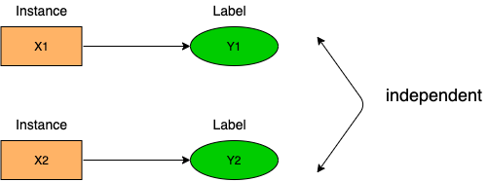
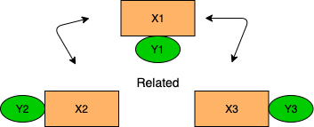
Why Graph network for Multi-Label Classification ?
Conventional classification approaches assume that instances are independent identically distributed
In relational data and information networks, instances are correlated with each other.

Slide 52
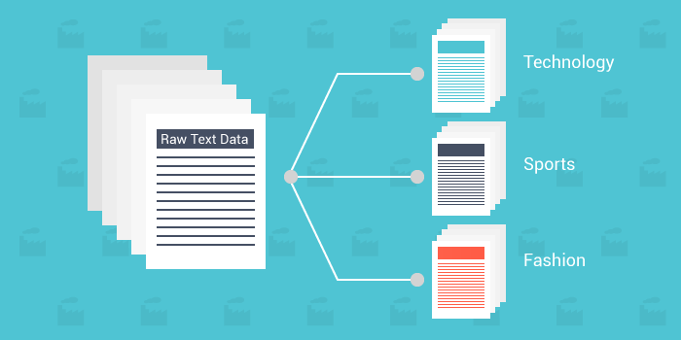
Why Graph network for Multi-Label Classification ?
In Multi-Label Text Classification (MLTC), one sample can belong to more than one class. It is observed that most MLTC tasks, there are dependencies or correlations among labels. Existing methods tend to ignore the relationship among labels.

Slide 53
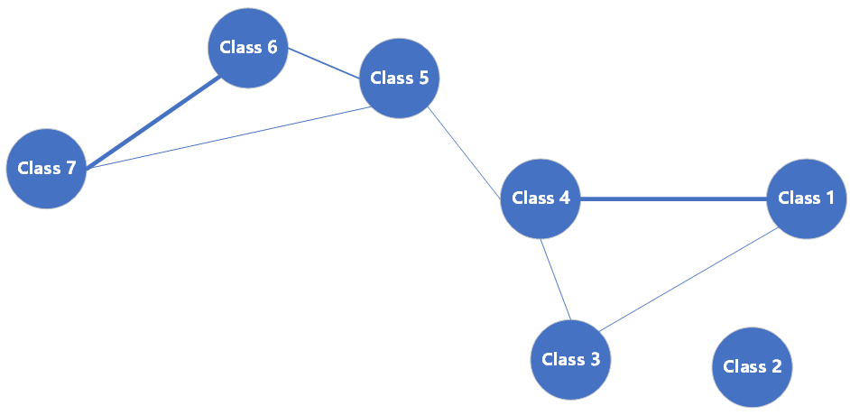
Our Proposed Model
In this paper, a graph attention network-based model is proposed to capture the attentive dependency structure among the labels. GAT network takes the node features and adjacency matrix that represents the graph data as inputs. In the context of our model, the embedding vectors of the labels act as the node features.

Slide 54
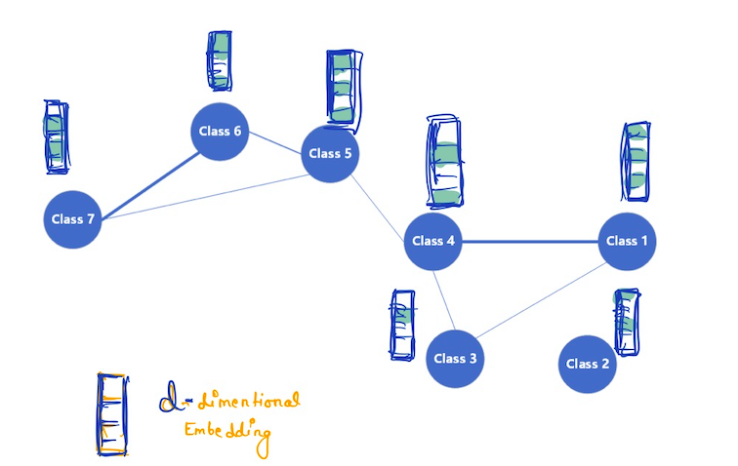
Feature Matrix In Graph network
Feature Matrix
Assigning n-dim embedding vectors to each label, feature vector N x F

Slide 55
Adjacency Matrix
Adjacency Matrix
Adj matrix is initialized by counting the pairwise co-occurrence of labels in dataset. N x N

Slide 56
Graph Network as feature extractor
MAGNET network’s components :
Feature Extraction
Correlation between labels

Slide 57
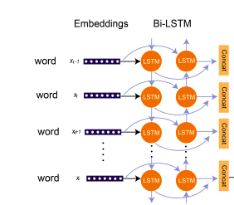

Graph Network as feature extractor
Feature Extraction
Extracting Text features using LSTM network

Slide 58

MAGNET Research Paper
Attention in Graph?

Slide 59


Graph Attention Network over Graph Convolution Network
In GCNs, the neighborhoods of nodes combine with equal or pre-defined weights. However, the influence of neighbors can vary greatly, and the attention mechanism can identify label importance in correlation graph by considering the importance of their neighbor labels.
In our experiment, we are using multi-head attention (Vaswani et al., 2017) that utilizes K different heads to describe labels relationship.

Slide 60


Graph Network as feature extractor
Using Graph attention network to find correlation between labels

Slide 61


Graph Network as feature extractor
Using both features to classify the documents. The proposed model with graph attention allows us to capture the dependency structure among labels for MLTC tasks.
Where F are the features obtained from Bi-LSTM and H_{gat} are the graph features from Graph attention network.

Slide 62


Graph Network as feature extractor
Result
State-of-the-art accuracy compared to 27
different deep learning models including bert
across five benchmark datasets

Slide 63

Applications
Learning Attention-based Embeddings for Relation Prediction in Knowledge Graphs
Key Points of Research Paper
Using Graph based Attention Model to learn the
relationships in Knowledge Graph
Using Entity and Relation embeddings as
input to Graph Model
Model learn a new representation of every edge
and aggregate the information by summing this over
the neighborhood multiplying with the
appropriate attention values.

Slide 64


Applications
Learning Attention-based Embeddings for Relation Prediction in Knowledge Graphs

Slide 65


Applications
Learning Attention-based Embeddings for Relation Prediction in Knowledge Graphs
Model

Slide 66

Applications
Learning Attention-based Embeddings for Relation Prediction in Knowledge Graphs
Result

Slide 67
Summary
How Message Passing works in Graph networks
How GCN perform aggregation
Similarities between GCN and CNN
GCN formulation
How Renormalization works
How to convert Text data into Graph for GCN
Heterogeneous Graphs
Implementation of GCN
Sentiment Analysis using GCN
Magnet Paper : Graph network as feature extractor
Knowledge graph using GCN

Slide 68
Questions?

